Slide 1


Slide 2
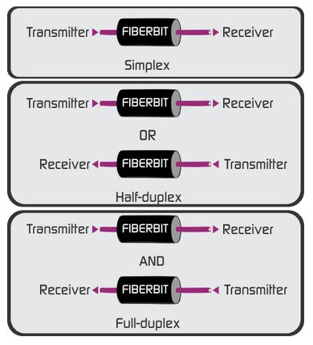
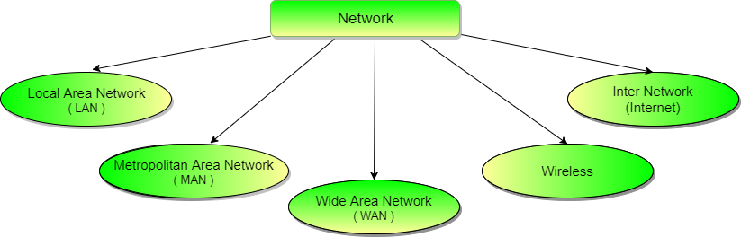
Network and Communication Types
Network Types Communication Types

Slide 3
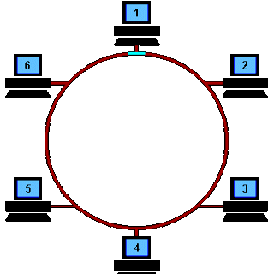
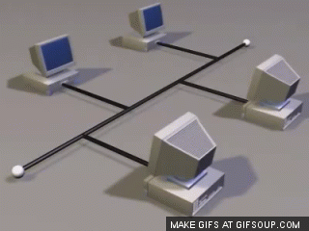
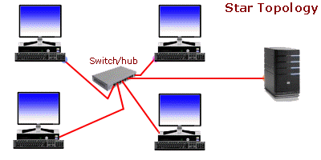
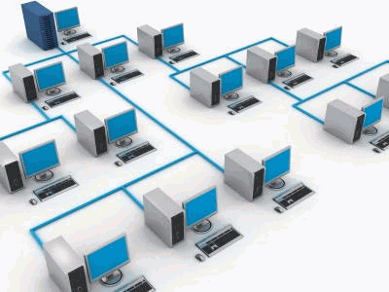
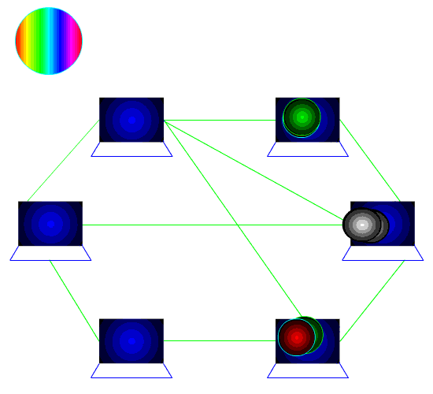
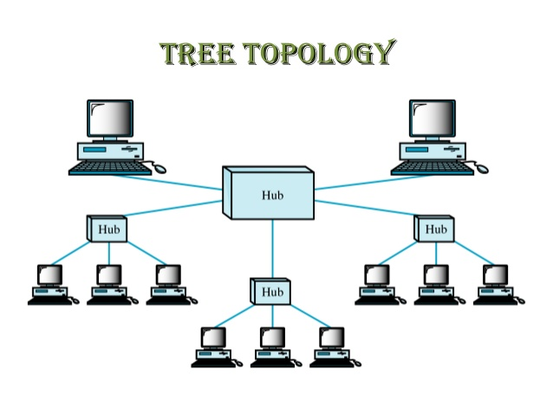
Network Topologies

Slide 4
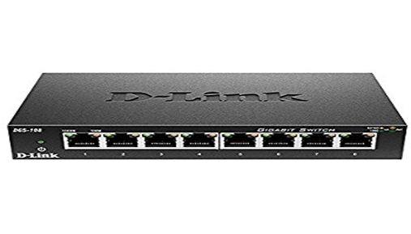
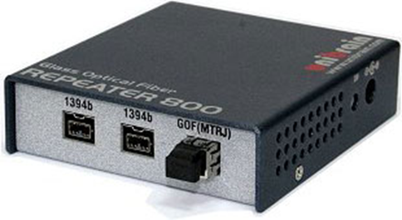
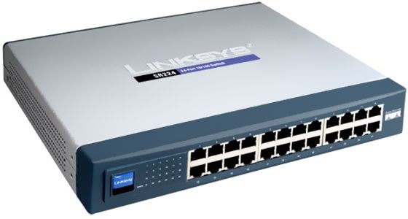
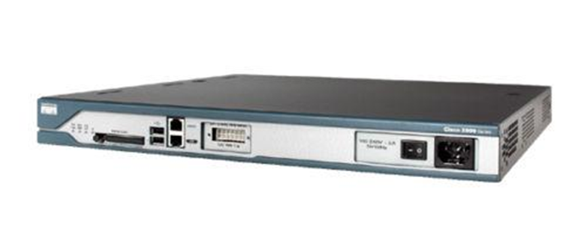
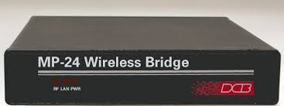
Network Devices
Switch
Repeaters
Hub
Router
Bridge

Slide 5


OSI Model
Internet
7
Application
Networks processes to applications
6
Presentation
Data representation
Session
Inter host communication
5
4
Transport
End-to-end connections
Network
Addresses and best path
Internet
3
Data Link
Access to media
Network Access
2
1
Physical
Binary Transmission

Slide 6
ADDRESSING THE NETWORK
Five types of Classes:
Class A
Class B
Class C
Class D
Class E
Three types of addresses in the network:
Network Address
Broadcast Address
Host Address
Multicast

Slide 7
ADDRESSING THE NETWORK
Five types of Classes:
Class A
Class B
Class C
Class D
Class E
Three types of addresses in the network:
Network Address
Broadcast Address
Host Address
Multicast
Three types of communication in network:
Unicast
Broadcast
Multicast
Different types of IP address:
Public IP Address
Private IP Address
Loopback Address

Slide 8
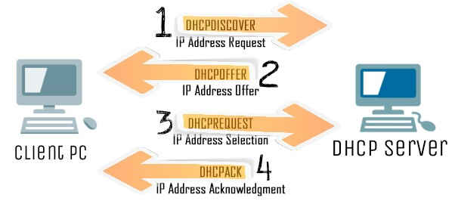
Dynamic Host Configuration Protocol
Logical Address
DHCP Process
ARP
Physical Address
Logical Address
RARP
Physical Address

Slide 9
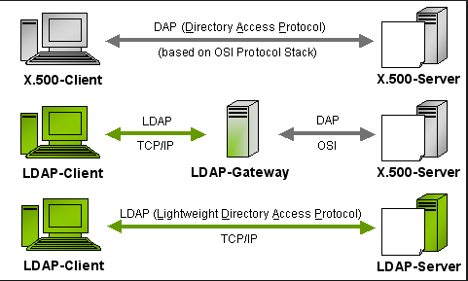
Directory Services
LDAP is an application protocol for querying and modifying items in directory service providers like Active Directory, which supports a form of LDAP.

Slide 10
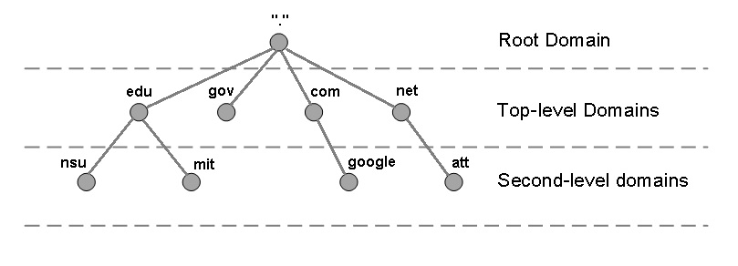

Domain Name Server (DNS)
Translates a domain name into corresponding IP address
DNS Hierarchy
74.125.225.74
192.168.1.2
DNS Query
Recursive Query
Iterative Query
DNS Records
A / AAAA
CNAME
PTR

Slide 11
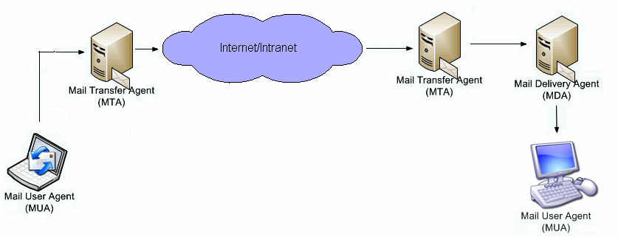
Mail Services

Slide 12
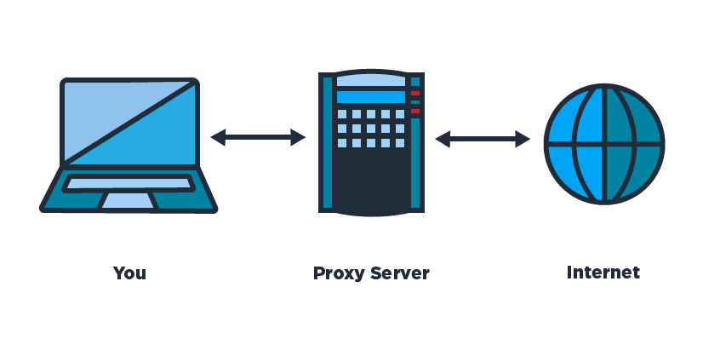
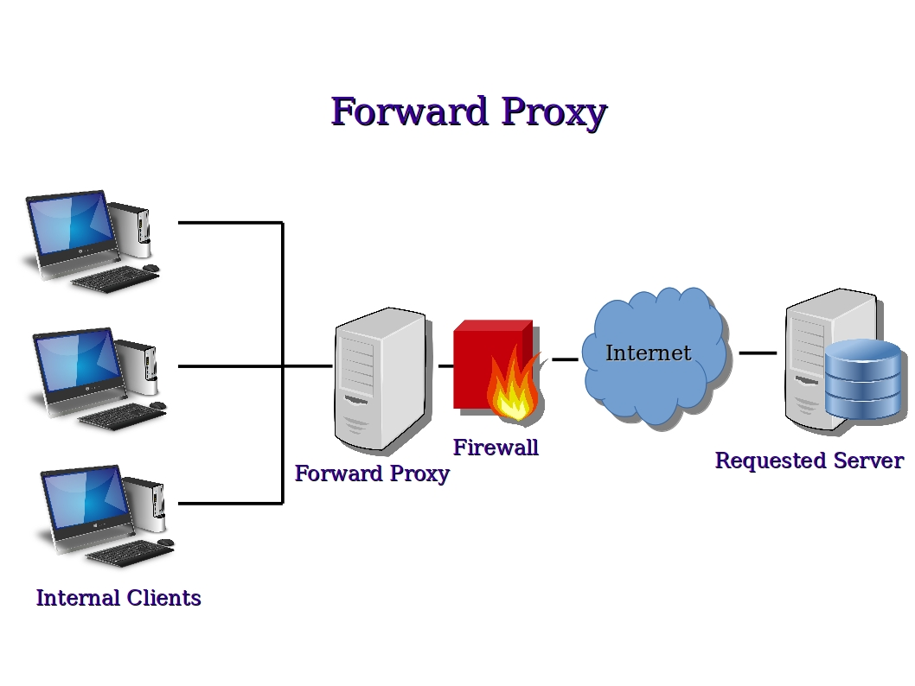
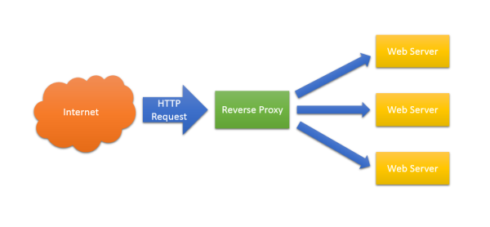
Proxy
Acts as an intermediary between the user's computer and the Internet
Types of Proxy :
Reverse Proxy

Slide 13
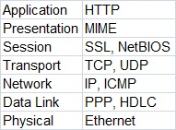
As you can see, the TCP/IP model has fewer layers than the OSI model. The Application, Presentation, and Session layers of the OSI model are merged in only one layer, Application layer, in the TCP/IP model. Also, Physical and Data Link layers are called Network Access layer in the TCP/IP model.

